Slide 1
Mobile Safety Project
Android
March 30. 2017

Slide 2
Similarity Steps
Freq + Control
Occur + Control
Frequency Matrix
Control Vocabulary
Find 10 Nearest Neighbors
Count how many apps rating are different
Sort descending, benchmark: #diff>=7
Tfidf + Control
Occurrence
Matrix
Cosine
Similarity
X
Freq + All
All Vocabulary
Tfidf
Matrix
Occur + All
Tfidf + All
Suspicious apps

Slide 3

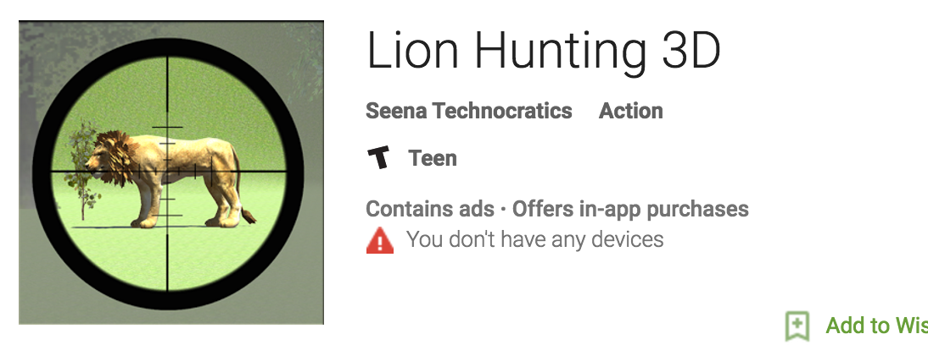

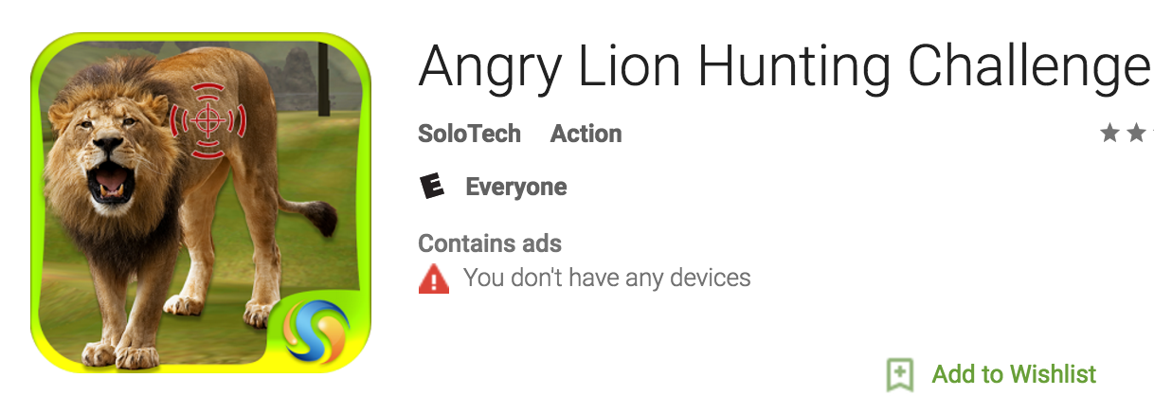


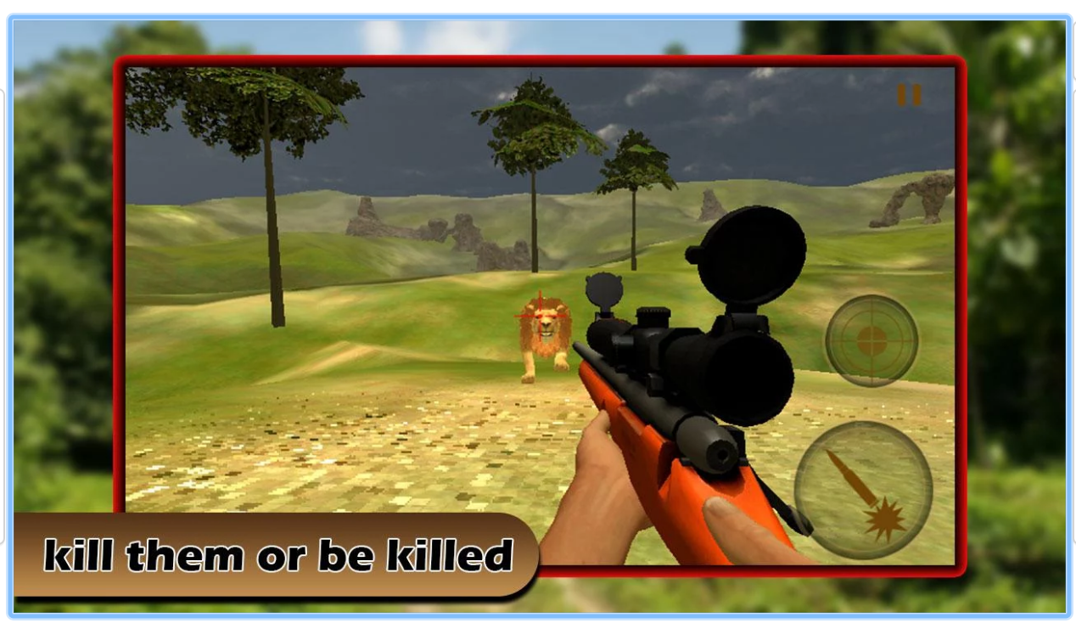
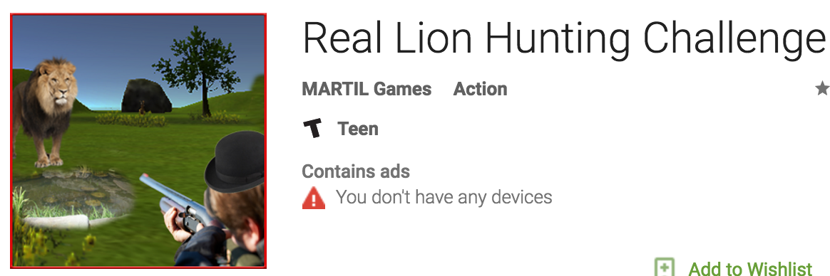


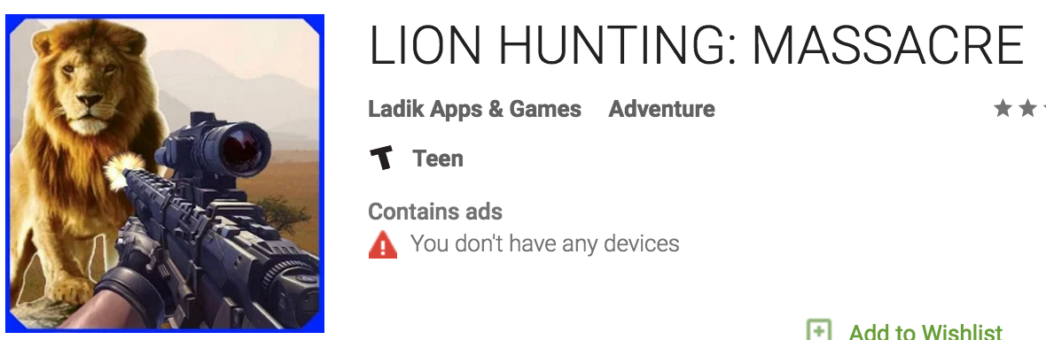
Teen
Teen
Teen
Everyone
Teen
Everyone 10+
Teen
Teen
Teen
Teen

Slide 4
Performance
Result_alltoken.xlsx
Number of different apps within 10 nearest neighbors >=7
Only look at ‘Everyone’ level
 | Freq + Control | Occur + Control | Tfidf + Control | Freq + All | Occur + All | Tfidf + All
Suspicious Apps Count | 182 | 116 | 190 | 323 | 270 | 321
False Positive | 39 | 19 | 71 | 70 | 115 | 76
FP% | 21.4% | 16.4% | 37.3% | 21.6% | 42.5% | 23.6%
False Positive: algorithm detect as suspicious app, but it actually should belong to ‘Everyone’ level.

Slide 5
Improvement
Control vocabulary: strong list * 2
In neighbors: ‘Maturity 17+’ *4, ‘Teen’ *3, ‘Everyone 10+’ *2

Slide 6
CACM magazine: 3000 words
Title: Is an ‘Everyone’ app really save for your kids?
To-Dos:
1.Different threshold :
# of suspicious app
% of suspicious app
2. Matching algorithm
3. 3 algorithm -> Probablity
4. Suspicious app list-> Mturk

